Slide 1
Introduction to Data Science
John P Dickerson
Lecture #8 – 9/19/2019
CMSC320
Tuesdays & Thursdays
5:00pm – 6:15pm

Slide 2
Announcements
Mini-Project #1 due date extended!
It is linked to from ELMS; also available at: https://github.com/umddb/cmsc320-fall2018/tree/master/project1
Deliverable is a .ipynb file submitted to ELMS
Now due on October 1st (one week from now)

Slide 3
Today’s Lecture
Data collection
Data processing
Exploratory analysis
&
Data viz
Analysis, hypothesis testing, & ML
Insight & Policy Decision
Just a taste!

Slide 4
Today’s Lecture
Missing Data …
What is it?
Simple methods for imputation
… with a tiny taste of Stats/ML lecturers to come.
Thanks to John Atwood and Wenjiang Fu

Slide 5
Missing Data
Missing data is information that we want to know, but don’t
It can come in many forms, e.g.:
People not answering questions on surveys
Inaccurate recordings of the height of plants that need to be discarded
Canceled runs in a driving experiment due to rain
Could also consider missing columns (no collection at all) to be missing data …
[JA]

Slide 6
Key Question
Why is the data missing?
What mechanism is it that contributes to, or is associated with, the probability of a data point being absent?
Can it be explained by our observed data or not?
The answers drastically affect what we can ultimately do to compensate for the missing-ness
[JA]

Slide 7
Complete Case Analysis
Delete all tuples with any missing values at all, so you are left only with observations with all variables observed
Default behavior for libraries for analysis (e.g., regression)
We’ll talk about this much more during the Stats/ML lectures
This is the simplest way to handle missing data. In some cases, will work fine; in others, ?????????????:
Loss of sample will lead to variance larger than reflected by the size of your data
May bias your sample
# Clean out rows with nil values
df = df.dropna()
[JA]

Slide 8
Example
Dataset: Body fat percentage in men, and the circumference of various body parts [Penrose et al., 1985]
Question: Does the circumference of certain body parts predict body fat percentage?
Given complete data, how would you answer this ?????????
One way to answer is regression analysis:
One or more independent variables ("predictors”)
One dependent variables (“outcome”)
What is the relationship between the predictors and the outcome?
What is the conditional expectation of the dependent variable given fixed values for the dependent variables?

Slide 9
Linear regression
Assumption: relationship between variables is linear:
(We’ll relax linearity, study in more depth later.)
Population Y-Intercept
Population Slope
Random Error
Y
=
β
+
β
X
+
ε
i
0
1
i
i
Dependent Variable (e.g., ????????)
Independent Variable(s) (e.g., ?????????)
[WF]

Slide 10
Population & Sample Regression Models
Population
☺
☺
☺
☺
☺
[WF]
Notes:
31

Slide 11
Population & Sample Regression Models
Population
Unknown Relationship
☺
☺
☺
☺
☺
[WF]
Notes:
32

Slide 12
Population & Sample Regression Models
Population
Random Sample
Unknown Relationship
☺
☺
☺
☺
☺
☺
☺
[WF]
Notes:
33

Slide 13
Population & Sample Regression Models
Population
Random Sample
Unknown Relationship
☺
☺
☺
☺
☺
☺
☺
[WF]
Notes:
34

Slide 14
Linear Regression
Observedvalue
ε_{i} = Random error
Observed value
[WF]
Notes:
35

Slide 15
Sample Linear Regression Model
ε_{i} = Random error
^
Unsampled observation
Observed value
[WF]
Notes:
36

Slide 16
Estimating Parameters: Least Squares Method
?
Notes:
40

Slide 17
Scatter plot
Plot all (X_{i}, Y_{i}) pairs, and plot your learned model
If you squint, suggests how well the model fits the data
Y
60
40
20
0
X
0
20
40
60
[WF]

Slide 18
QUestion
How would you draw a line through the points?
How do you determine which line “fits the best” …? ?????????
Y
60
40
20
0
X
0
20
40
60
[WF]
Notes:
42

Slide 19
Question
How would you draw a line through the points?
How do you determine which line “fits the best” ?????????
Slope changed
Y
60
40
20
0
X
0
20
40
60
Intercept unchanged
[WF]
Notes:
43

Slide 20
Question
How would you draw a line through the points?
How do you determine which line “fits the best” ?????????
Slope unchanged
Y
60
40
20
0
X
0
20
40
60
Intercept changed
[WF]
Notes:
44

Slide 21
Question
How would you draw a line through the points?
How do you determine which line “fits the best” ?????????
Slope changed
Y
60
40
20
0
X
0
20
40
60
Intercept changed
[WF]
Notes:
45

Slide 22
Least Squares
Best fit: difference between the true Y-values and the estimated Y-values is minimized:
Positive errors offset negative errors …
… square the error!
Least squares minimizes the sum of the squared errors
Why squared? We’ll cover this in more depth in a few weeks.
Until then: http://www.benkuhn.net/squared
[WF]
Notes:
51

Slide 23
Least Squares, Graphically
[WF]
Notes:
52

Slide 24
Interpretation of Coefficients
^
Slope (β₁):
Estimated Y changes by β₁ for each unit increase in X
If β₁ = 2, then Y Is expected to increase by 2 for each 1 unit increase in X
Y-Intercept (β₀)
Average value of Y when X = 0
If β₀ = 4, then average Y is expected to be 4 when X Is 0
^
^
^
In-depth analysis of less naïve approaches to come!
[WF]

Slide 25
Now, Back to Missing Data …

Slide 26
Example
Question: Does the circumference of certain body parts predict BF%?
Assumption: BF% is a linear function of measurements of various body parts and other features …
Analysis: Results from a regression model with BF% …
Predictor | Estimate | S.E. | p-value
Age | 0.0626 | 0.0313 | 0.0463
Neck | -0.4728 | 0.2294 | 0.0403
Forearm | 0.45315 | 0.1979 | 0.0229
Wrist | -1.6181 | 0.5323 | 0.0026
(Interpretation ???????????)
[JA]
Notes:
Standard error – estimate of the standard deviation, will talk about this more later …
The p-value is the probability of obtaining a result equal to or "more extreme" than what was actually observed, when the null hyp is actually true – we’ll talk about this more …

Slide 27
What If data were missing?
In this case, the dataset is complete:
But what if 5 percent of the participants had missing values? 10 percent? 20 percent?
What if we performed complete case analysis and removed those who had missing values?
First let’s examine the effect if we do this if when the data is missing completely at random (MCAR)
Removed cases at random, reran analysis, stored the p-values
p-value: probability of getting at least as extreme a result as what we observed given that there is no relationship
Repeat 1000 times, plot p-values …
[JA]

Slide 28
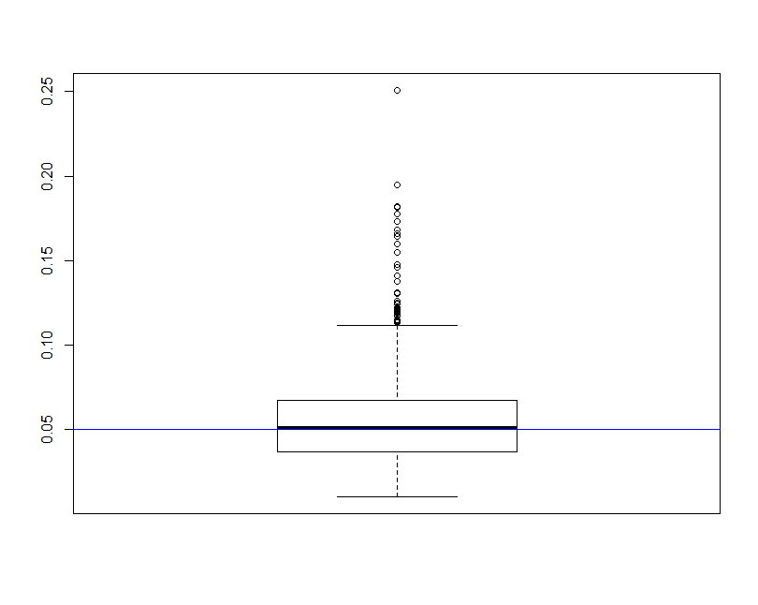
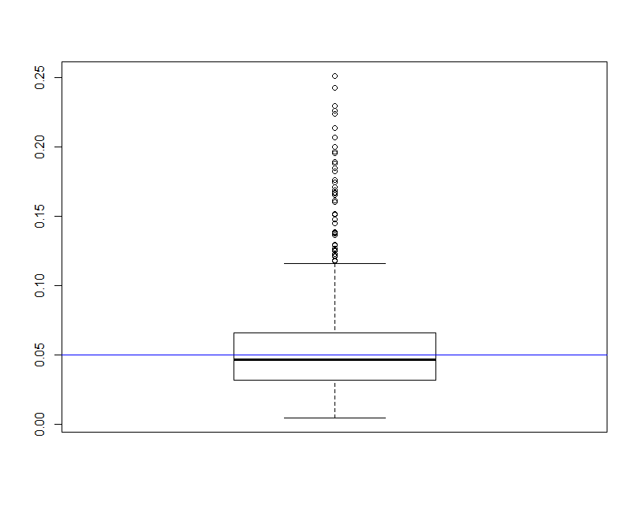
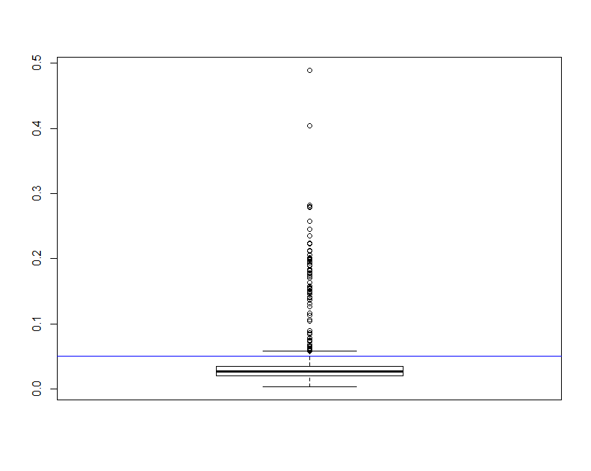
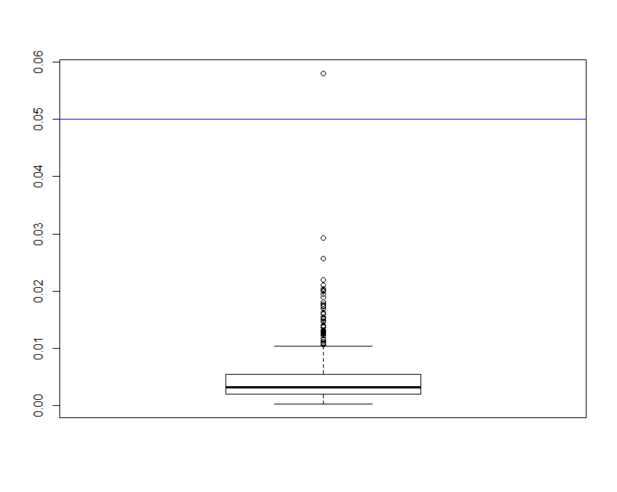
~5% Deleted (N=13)
p-value
Age
Neck
Forearm
Wrist
[JA]

Slide 29
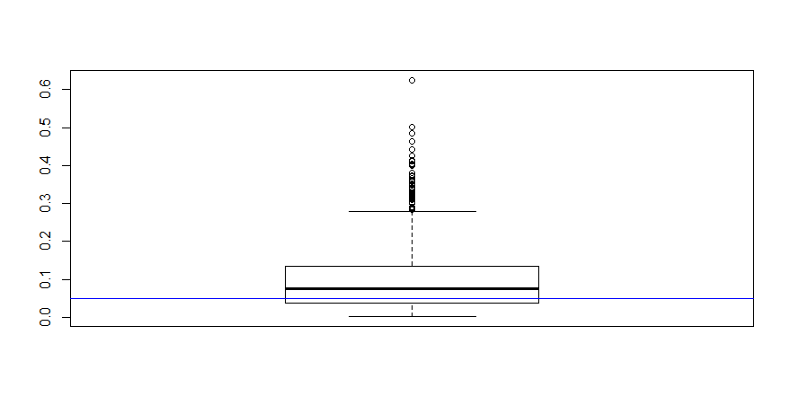
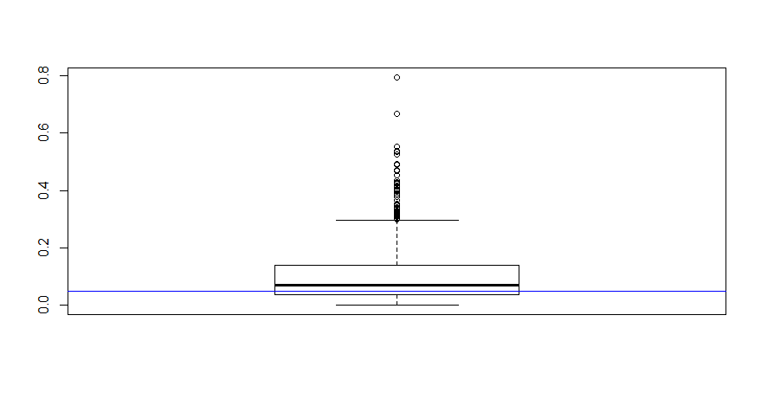
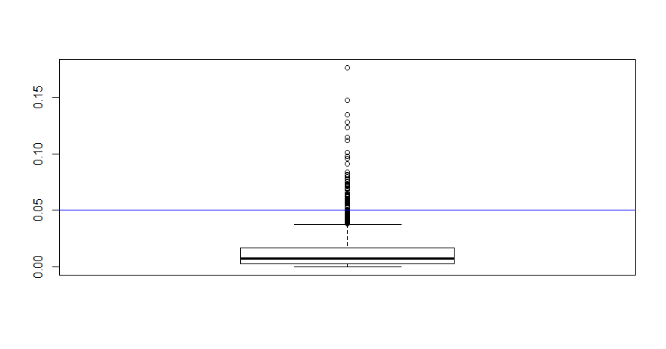
~20% Deleted (N=50)
p-value
Age
Forearm
Wrist
Neck
[JA]

Slide 30
Conclusions seem to change …
Age/Neck: fail to reject the null hypothesis usually?
vs
Age (5%)
Neck (5%)
Age (20%)
Neck (20%)
Still reject Forearm/Wrist most of the time
This is assuming the missing subjects’ distribution does not differ from the non-missing. This would cause bias …
[JA]

Slide 31
Types Of Missing-ness
Missing Completely at Random (MCAR)
Missing at Random (MAR)
Missing Not at Random (MNAR)
[JA]

Slide 32
What Distinguishes Each Type of missing-ness?
Suppose you’re loitering outside of CSIC one day …
Students just received their mid-semester grades
You start asking passing students their CMSC131 grades
You don’t force them to tell you or anything
You also write down their gender and hair color
[JA]

Slide 33
Your Sample
Hair Color | Gender | Grade
Red | M | A
Brown | F | A
Black | F | B
Black | M | A
Brown | M
Brown | M
Brown | F
Black | M | B
Black | M | B
Brown | F | A
Black | F
Brown | F | C
Red | M
Red | F | A
Brown | M | A
Black | M | A
Summary:
7 students received As
3 students received Bs
1 student received a C
Nobody is failing!
But 5 students did not reveal their grade …
[JA]

Slide 34
What influences a data point’s Presence?
Same dataset, but the values are replaced with a “0” if the data point is observed and “1” if it is not
Question: for any one of these data points, what is the probability that the point is equal to “1” …?
What type of missing-ness do the grades exhibit?
Hair Color | Gender | Grade
0 | 0 | 0
0 | 0 | 0
0 | 0 | 0
0 | 0 | 0
0 | 0 | 1
0 | 0 | 1
0 | 0 | 1
0 | 0 | 0
0 | 0 | 0
0 | 0 | 0
0 | 0 | 1
0 | 0 | 0
0 | 0 | 1
0 | 0 | 0
0 | 0 | 0
0 | 0 | 0
[JA]

Slide 35
MCAR: Missing Completely at Random
If this probability is not dependent on any of the data, observed or unobserved, then the data is Missing Completely at Random (MCAR)
Suppose that X is the observed data and Y is the unobserved data. Call our “missing matrix” R
Then, if the data are MCAR, P(R|X,Y) = ??????????
P(R|X,Y) = P(R)
Probability of those rows missing is independent of anything.
[JA]

Slide 36
Totally Realistic MCAR Example
You are running an experiment on plants grown in pots, when suddenly you have a nervous breakdown and smash some of the pots
You will probably not choose the plants to smash in a well-defined pattern, such as height age, etc.
Hence, the missing values generated from your act of madness will likely fall into the MCAR category
[JA]

Slide 37
Applicability of MCAR
A completely random mechanism for generating missing-ness in your data set just isn’t very realistic
Usually, missing data is missing for a reason:
Maybe older people are less likely to answer web-delivered questions on surveys
In longitudinal studies people may die before they have completed the entire study
Companies may be reluctant to reveal financial information

Slide 38
MAR: Missing at Random
Missing at Random (MAR): probability of missing data is dependent on the observed data but not the unobserved data
Suppose that X is the observed data and Y is the unobserved data. Call our “missing matrix” R
Then, if the data are MAR, P(R|X,Y) = ??????????
P(R|X,Y) = P(R|X)
Not exactly random (in the vernacular sense).
There is a probabilistic mechanism that is associated with whether the data is missing
Mechanism takes the observed data as input

Slide 39
ExampleS?
?

Slide 40
MAR: Key Point
We can model that latent mechanism and compensate for it
Imputation: replacing missing data with substituted values
Models today will assume MAR
Example: if age is known, you can model missing-ness as a function of age
Whether or not missing data is MAR or the next type, Missing Not at Random (MNAR), is not* testable.
Requires you to “understand” your data
*unless you can get the missing data (e.g., post-study phone calls)

Slide 41
MNAR: Missing Not at Random
MNAR: missing-ness has something to do with the missing data itself
Examples: ??????????
Do you binge drink? Do you have a trust fund? Do you use illegal drugs? What is your sexuality? Are you depressed?
Said to be “non-ignorable”:
Missing data mechanism must be considered as you deal with the missing data
Must include model for why the data are missing, and best guesses as to what the data might be

Slide 42
Back to CSIC …
Is the the missing data:
MCAR;
MAR; or
MNAR?
???????????
Hair Color | Gender | Grade
Red | M | A
Brown | F | A
Black | F | B
Black | M | A
Brown | M
Brown | M
Brown | F
Black | M | B
Black | M | B
Brown | F | A
Black | F
Brown | F | C
Red | M
Red | F | A
Brown | M | A
Black | M | A

Slide 43
Add a variable
Bring in the GPA:
Does this change anything?
Hair Color | GPA | Gender | Grade
Red | 3.4 | M | A
Brown | 3.6 | F | A
Black | 3.7 | F | B
Black | 3.9 | M | A
Brown | 2.5 | M
Brown | 3.2 | M
Brown | 3.0 | F
Black | 2.9 | M | B
Black | 3.3 | M | B
Brown | 4.0 | F | A
Black | 3.65 | F
Brown | 3.4 | F | C
Red | 2.2 | M
Red | 3.8 | F | A
Brown | 3.8 | M | A
Black | 3.67 | M | A

Slide 44
Handling Missing Data …

Slide 45
Single Imputation
Mean imputation: imputing the average from observed cases for all missing values of a variable
Hot-deck imputation: imputing a value from another subject, or “donor,” that is most like the subject in terms of observed variables
Last observation carried forward (LOCF): order the dataset somehow and then fill in a missing value with its neighbor
Cold-deck imputation: bring in other datasets
Old and busted:
All fundamentally impose too much precision.
Have uncertainty over what unobserved values actually are
Developed before cheap computation

Slide 46
Multiple Imputation
Developed to deal with noise during imputation
Impute once → treats imputed value as observed
We have uncertainty over what the observed value would have been
Multiple imputation: generate several random values for each missing data point during imputation

Slide 47
Imputation Process
s₁
a₁
Incomplete data
s₂
a₂
Pooled results
s_{N}
a_{N}
Impute N times
Analysis performed on each imputed set

Slide 48
Tiny example
X | Y
32 | 2
43 | ?
56 | 6
25 | ?
84 | 5
Independent variable: X
Dependent variable: Y
We assume Y has a linear relationship with X

Slide 49
Let’s Impute Some Data!
Use a predictive distribution of the missing values:
Given the observed values, make random draws of the observed values and fill them in.
Do this N times and make N imputed datasets
X | Y
32 | 2
43 | 5.5
56 | 6
25 | 8
84 | 5
X | Y
32 | 2
43 | 7.2
56 | 6
25 | 1.1
84 | 5
For very large values of N=2 …

Slide 50
Inference with Multiple Imputation
Now that we have our imputed data sets, how do we make use of them? ???????????
Analyze each of the separately
X | Y
32 | 2
43 | 5.5
56 | 6
25 | 8
84 | 5
X | Y
32 | 2
43 | 7.2
56 | 6
25 | 1.1
84 | 5
Slope | -0.8245
Standard error | 6.1845
Slope | 4.932
Standard error | 4.287
Y
=
β
+
β
X
+
ε
Y
=
β
+
β
X
+
ε
i
0
1
i
i
i
0
1
i
i

Slide 51
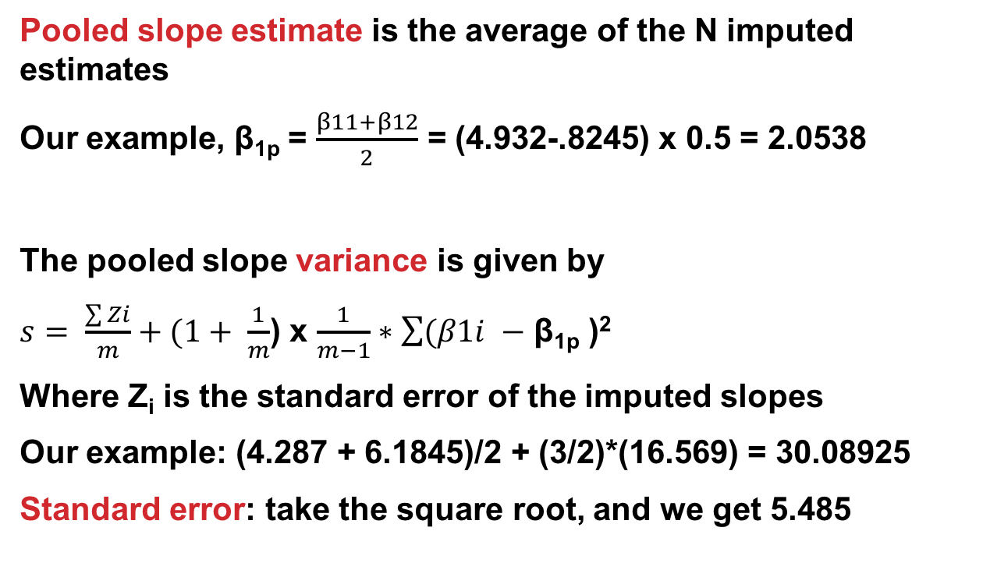
Pooling analyses
Pooled slope estimate is the average of the N imputed estimates
Our example, β_{1p} = $\frac{β11+β12}{2}$ = (4.932-.8245) x 0.5 = 2.0538
The pooled slope variance is given by
$s= \frac{\sum{Zi}}{m}+(1+ \frac{1}{m}$) x $\frac{1}{m−1}∗\sum{(β1i }−$ β_{1p} )²
Where Z_{i} is the standard error of the imputed slopes
Our example: (4.287 + 6.1845)/2 + (3/2)*(16.569) = 30.08925
Standard error: take the square root, and we get 5.485
Notes:
For those following from home:
Variance: roughly how much a set of numbers are “spread around” their mean
Standard deviation: similar to variance (square root of variance) – same units as main data
Standard error (of the sample mean): how far the sample mean is from the population mean

Slide 52
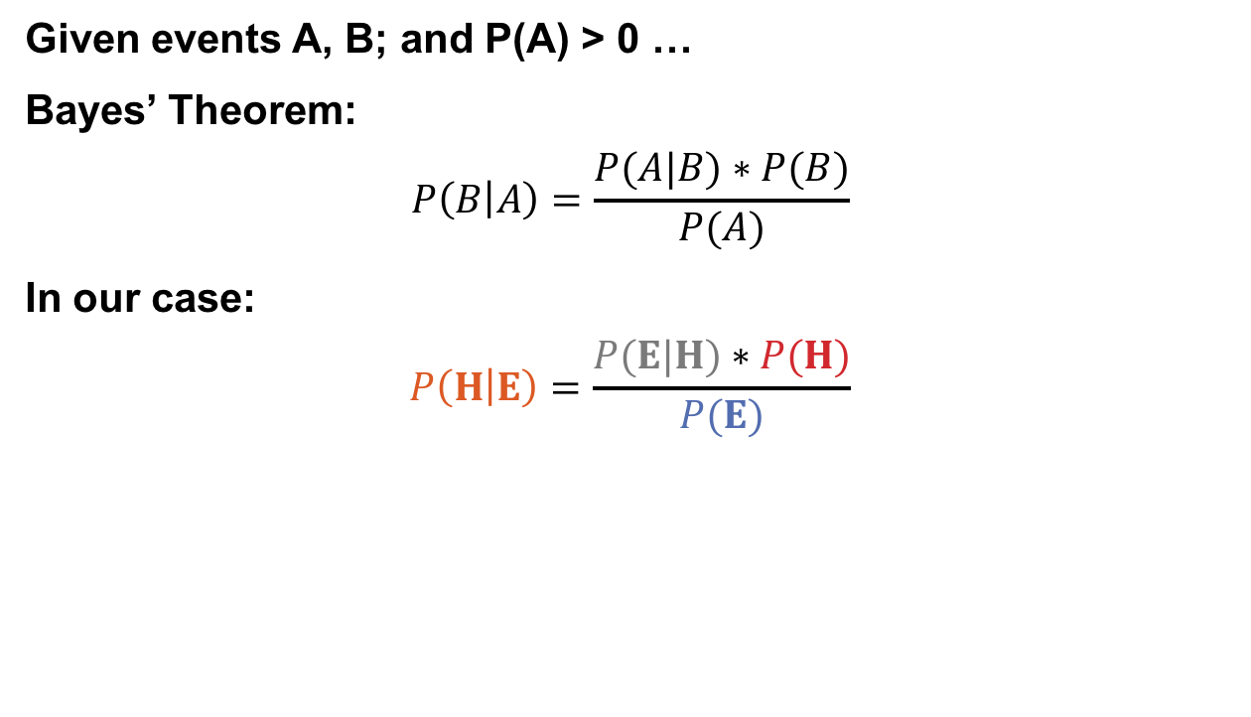
Predicting the missing data given the observed data
Given events A, B; and P(A) > 0 …
Bayes’ Theorem:
$$P\left(B | A\right)=\frac{P(A|B)∗P(B)}{P(A)}$$
In our case:
$$P\left(H | E\right)=\frac{P(E|H)∗P(H)}{P(E)}$$
Probability of seeing evidence given the hypothesis
Prior probability of hypotheses
Posterior probability of the hypothesis given the evidence
Prior over the evidence

Slide 53
Bayesian Imputation
Establish a prior distribution:
Some distribution of parameters of interest θ before considering the data, P(θ)
We want to estimate θ
Given θ, can establish a distribution P(X_{obs}|θ)
Use Bayes Theorem to establish P(θ|X_{obs}) …
Make random draws for θ
Use these draws to make predictions of Y_{miss}

Slide 54
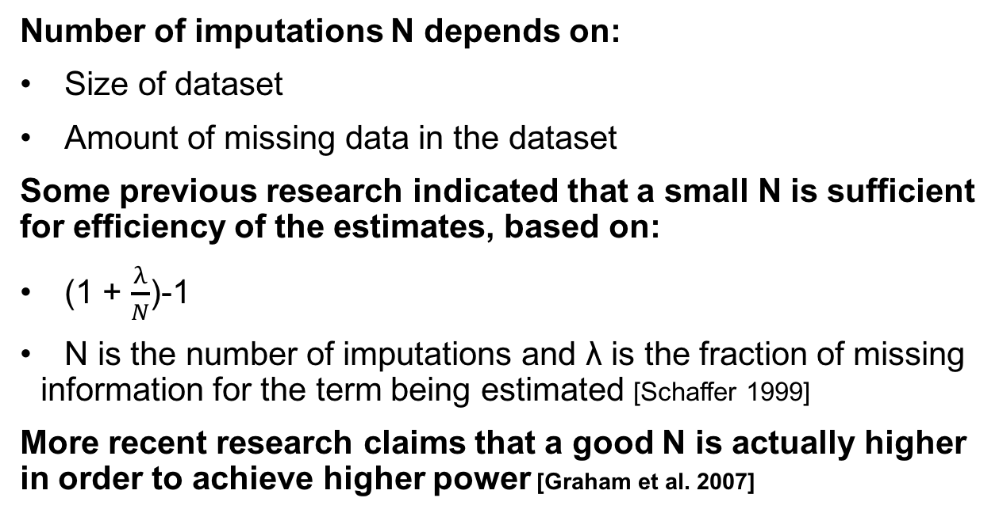
How big should N Be?
Number of imputations N depends on:
Size of dataset
Amount of missing data in the dataset
Some previous research indicated that a small N is sufficient for efficiency of the estimates, based on:
(1 + $\frac{λ}{N}$)-1
N is the number of imputations and λ is the fraction of missing information for the term being estimated [Schaffer 1999]
More recent research claims that a good N is actually higher in order to achieve higher power [Graham et al. 2007]

Slide 55
More advanced methods
Interested? Further reading:
Regression-based MI methods
Multiple Imputation Chained Equations (MICE) or Fully Conditional Specification (FCS)
Readable summary from JHU School of Public Health: https://www.ncbi.nlm.nih.gov/pmc/articles/PMC3074241/
Markov Chain Monte Carlo (MCMC)
We’ll cover this a bit, but also check out CMSC422!

Slide 56
Next Class: Summary Statistics &Visualization

